Slide 1
TURBINE HEALTH MONITORING AND FAILURE FORECASTING
PRESENTED BY
A.S.S.V.AKSHAI

Slide 2
OVERVIEW
Wind turbines are an important source of renewable energy, but continuous operation can lead to mechanical faults and unexpected failures. These failures may cause downtime, increased maintenance costs, and reduced power generation.
This project aims to develop a machine learning-based system that monitors the health of wind turbines and predicts possible failures in advance. The model analyses key parameters such as Wind Speed, Rotor Speed, Blade Angle, Gearbox Temperature, Generator Temperature, and Vibration to identify abnormal conditions.
By predicting faults like gearbox, generator, or blade failures before they occur, the system helps in timely maintenance, reduces downtime, and improves the overall efficiency and reliability of wind turbines.

Slide 3
OBJECTIVES
The goal of this project is to develop a predictive model for monitoring the health of wind turbines and forecasting potential failures. By analyzing key operational parameters such as Windspeed, Rotor Speed, Blade Angle, Gearbox Temperature, GeneratorTemperature, and Vibration, we aim to:
Identify patterns or conditions that lead to failures.
Predict specific types of failures (e.g., gearbox, generator, blade) before they occur.
Improve turbine uptime and optimize maintenance schedules, reducing downtime and operational costs.

Slide 4
METHODOLOGY
Data Exploring and Preprocessing:
Loaded and analyzed the dataset, handled missing values, and removed duplicates.
Cleaned data, encoded categorical variables, and prepared it for model training.
Created new features like Temperature Difference, Power Efficiency, Vibration Risk, and Maintenance Risk using NumPy and Pandas.
2. Exploratory Data Analysis (EDA):
Performed EDA to understand relationships between turbine parameters and failure conditions.
Used statistical summaries and visualizations like histograms, box plots, and correlation analysis to identify patterns and outliers.
Created visualizations such as correlation heatmap, fault type distribution, target variable distribution, vibration vs failure, wind speed vs power output.

Slide 5
3. Model Selection and Training:
Trained multiple machine learning models on processed data by splitting it into training and testing sets.
Tested algorithms like Logistic Regression, Decision Tree, Random Forest, and Gradient Boosting/XGBoost for failure prediction.
Compared model performance to select the best-performing model for accurate predictions.
4. Failure Type Prediction:
Used the best-performing model to predict not only failure occurrence but also the specific type of failure.
Predictions were based on key parameters like wind speed, rotor speed, blade angle, temperatures, and vibration.
Classified failures into categories such as gearbox failure, generator failure, blade failure, and normal condition.

Slide 6
5. Hyper Parameter Tuning:
Performed hyperparameter tuning to improve model accuracy and overall performance.
Used techniques like GridSearchCV and RandomizedSearchCV to find the best parameter combinations.
Tuned parameters such as number of trees, tree depth, split conditions, and criteria to avoid overfitting and improve generalization.
6. Post Model Analysis:
Evaluated model performance using metrics like accuracy, precision, recall, and F1-score.
Used confusion matrix to analyze correct predictions, false positives, and false negatives.
Analyzed feature importance using SHAP to understand the impact of parameters on predictions.

Slide 7
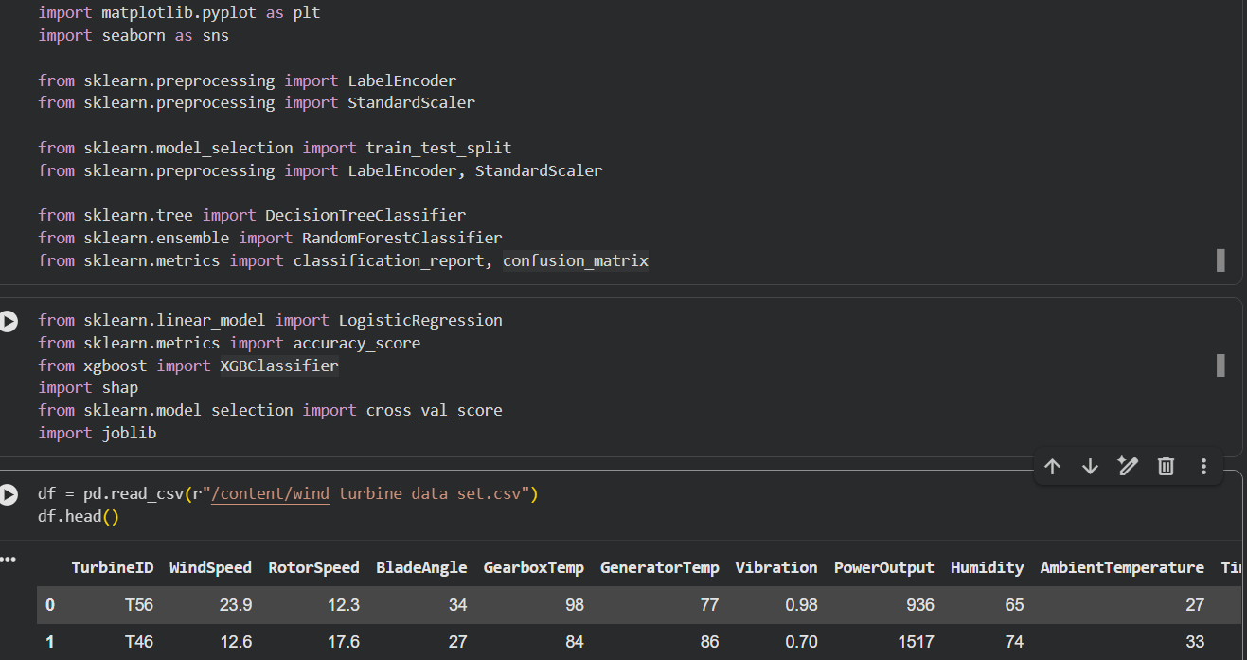
VISUALIZATIONS

Slide 8
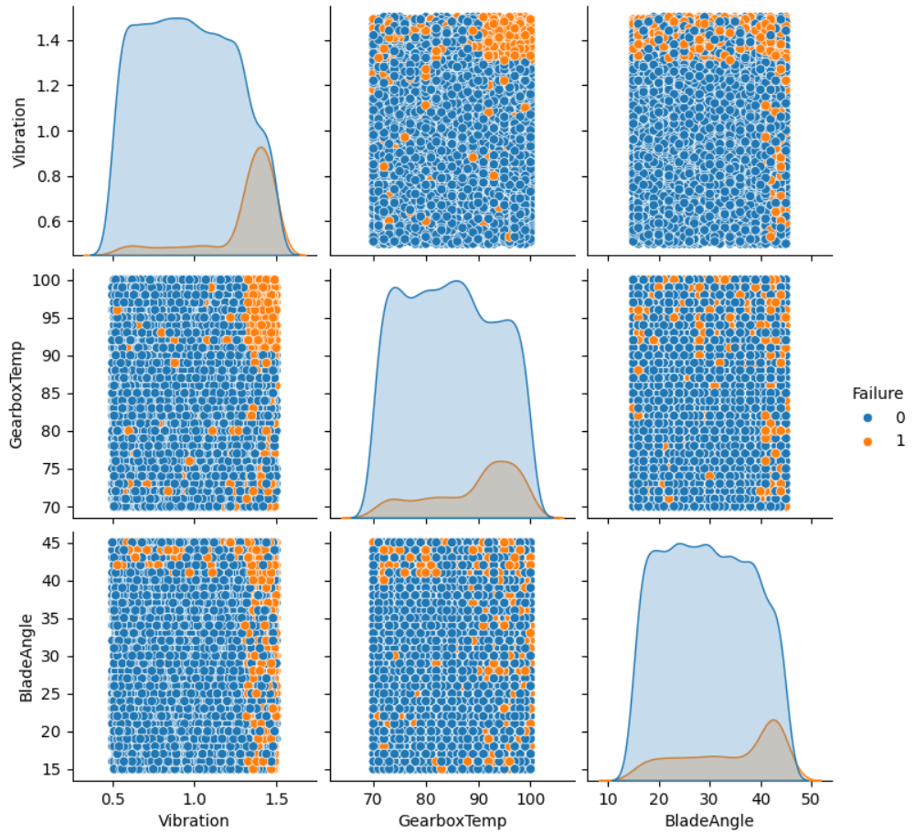

Slide 9
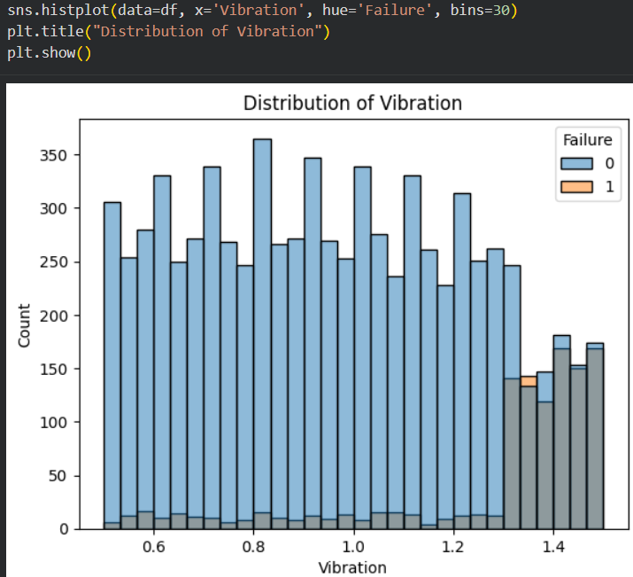
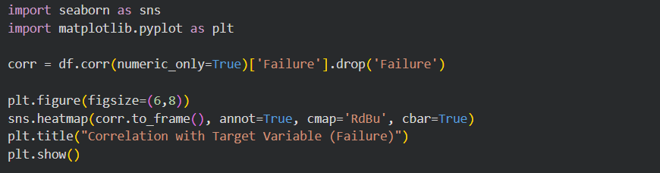
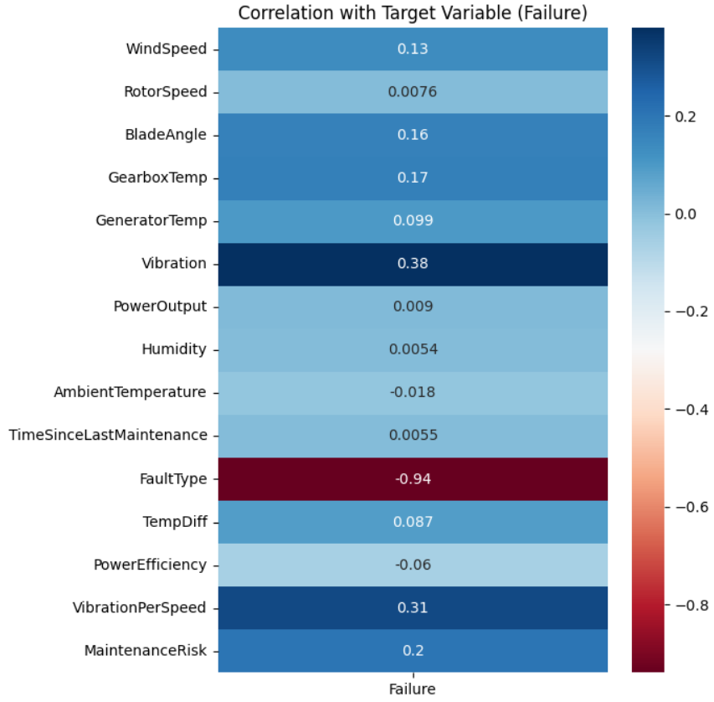

Slide 10




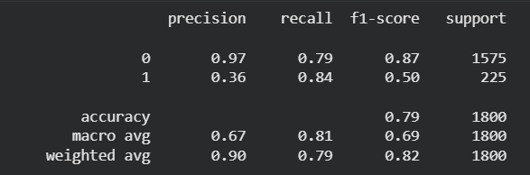
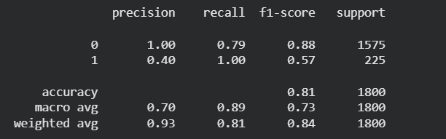
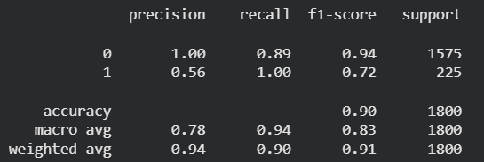
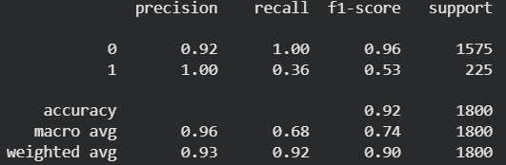

Slide 11
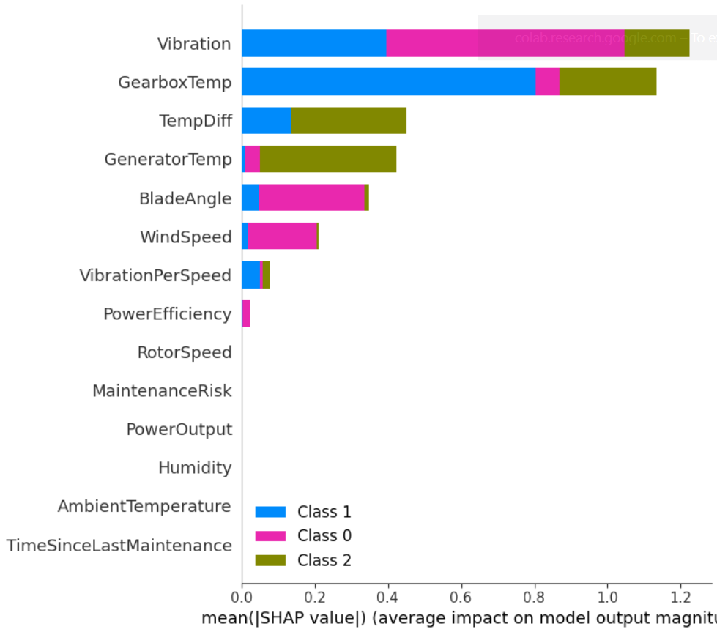
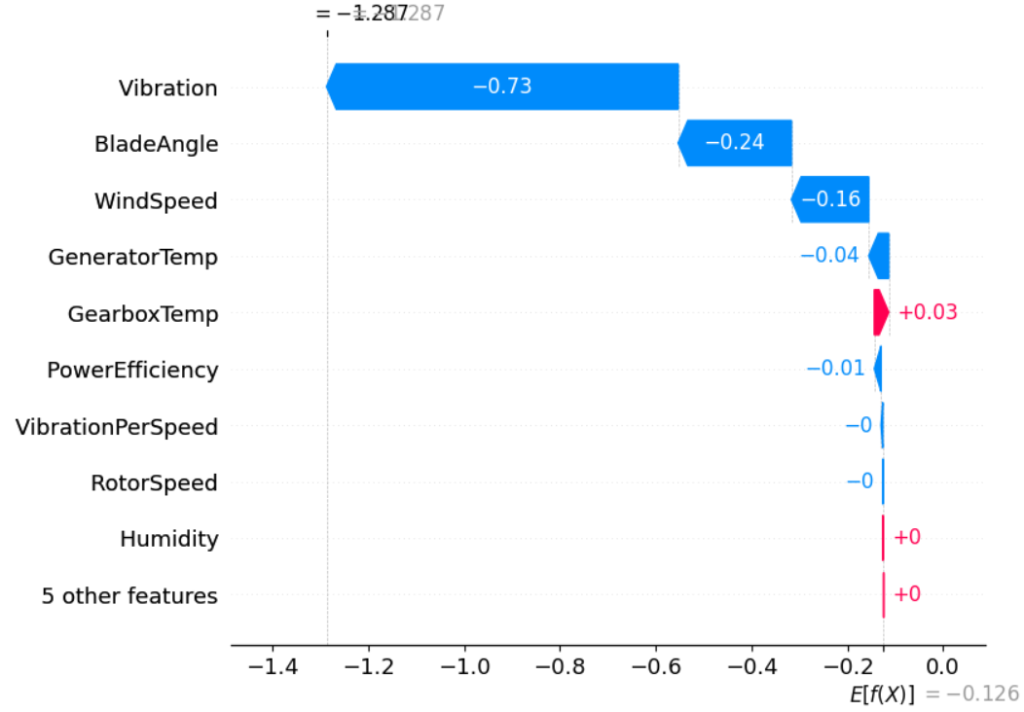
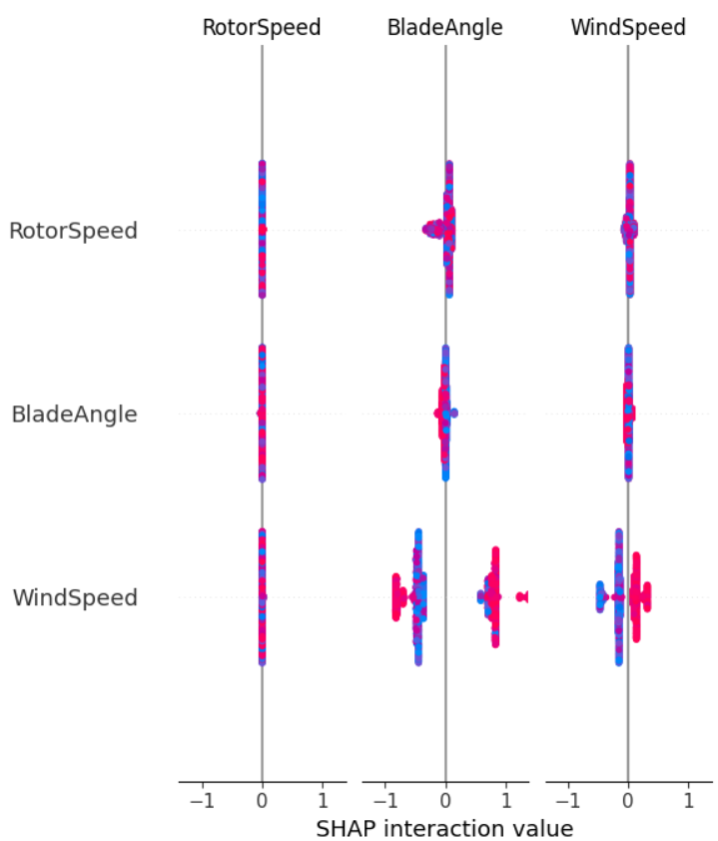

Slide 12
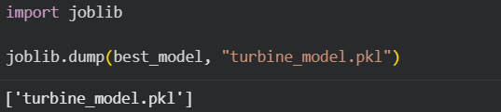
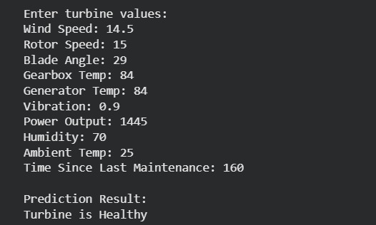
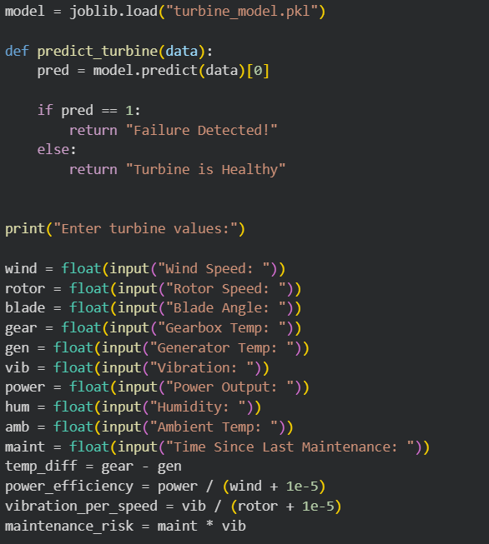
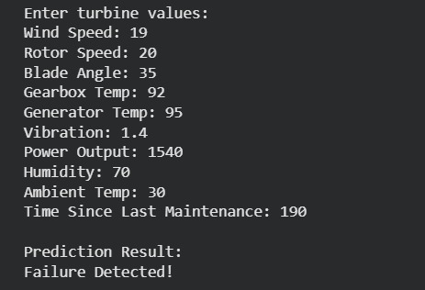

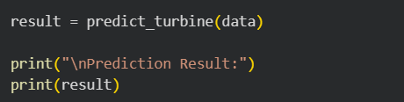

Slide 13
CHALLENGES FACED
Data Imbalance Issue:
The dataset had a large number of non-failure cases compared to failure cases, which made it difficult for models to correctly predict minority classes.
The data imbalance issue was addressed by focusing on evaluation metrics like recall and F1-score instead of only accuracy.
2. Improving Model Performance:
Multiple models such as Logistic Regression, Decision Tree, Random Forest, and XGBoost were tested and compared.
Finally, XGBoost was selected as it provided better accuracy and overall performance.
3. Feature Impact Understanding:
Initially, it was difficult to understand which features were influencing the predictions.
This challenge was solved using SHAP analysis, which helped identify important features like vibration and temperature.

Slide 14
CONCLUSION
The model results made it easier to understand turbine performance and identify critical failure patterns
Overall, the system provided a clear and effective approach for monitoring turbine health and improving maintenance decisions.
The analysis highlights that data-driven techniques are essential for predicting failures, optimizing performance, and reducing operational risks.
Key features like vibration and temperature played a major role in accurately detecting turbine failures.
The project demonstrates how machine learning can be effectively applied for real-time industrial monitoring and predictive maintenance.

